Slide 1
机器学习与神经网络计算
第二章，
管吉松

Slide 2
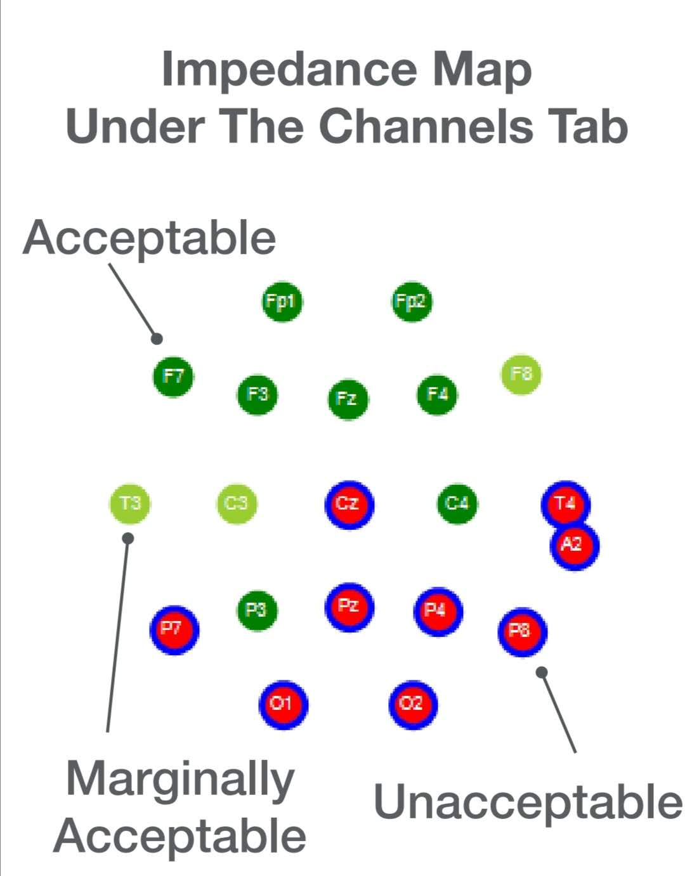
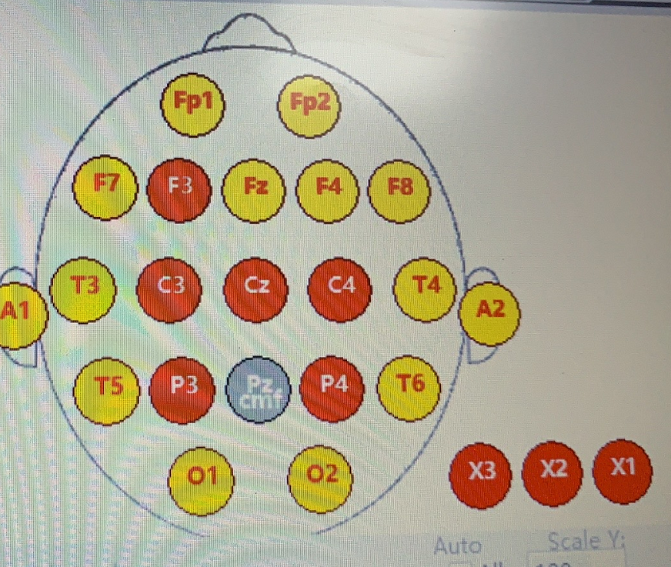
脑机接口 数据探索

Slide 3
FFT

Slide 4
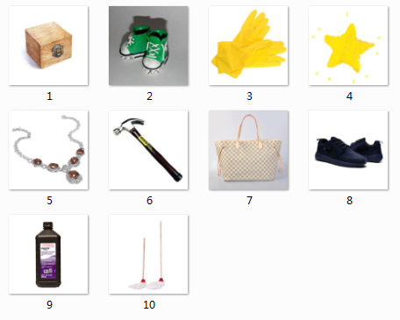


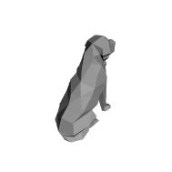
1.Memorize 10 pictures
in 3min
2.Rest without pictures
1min
3.Test trials:
Match trials
Non-match trials
3s
3s
3s
3s
1s
1s

Slide 5
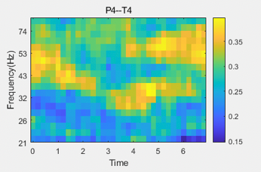
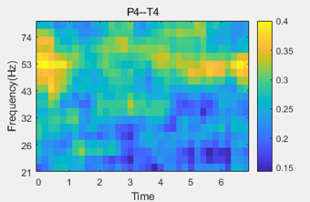
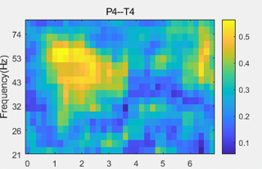
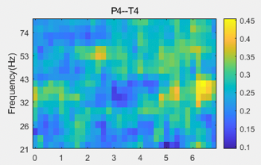
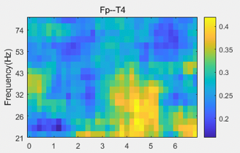
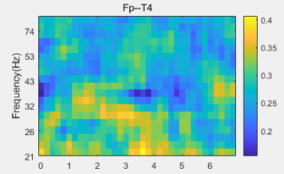
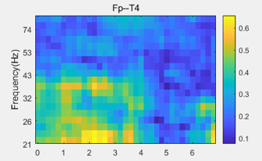
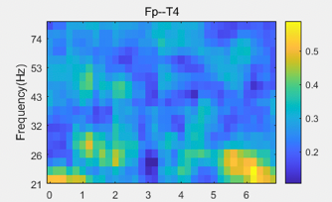
OS 信号可能作为认知/能力 检测的一个信息指标
Memory trial
Novel trial
Same trial
different trial
Person-4

Slide 6
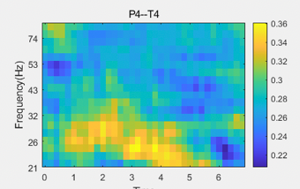
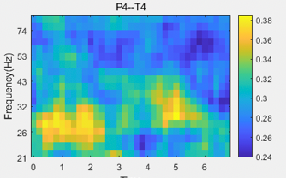
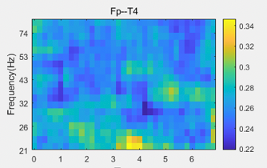
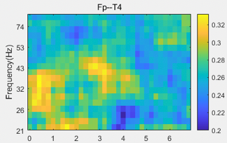
Person 4 不同人可能信号存在差异

Slide 7
如何对不同信息特征进行整合分类呢？

Slide 8
第一节， 分类与模式识别

Slide 9
模式识别系统构成
特征提取与选择
分类器
设计
数据获取
特征提取与选择
数据获取
测试

Slide 10
















Slide 11
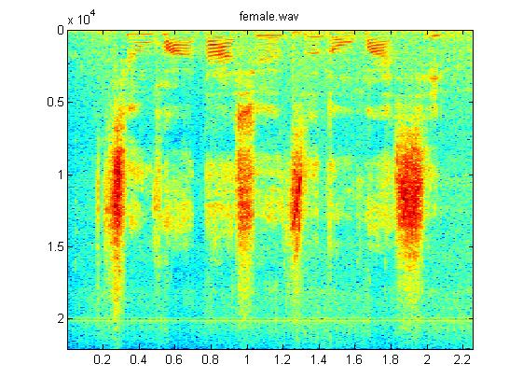
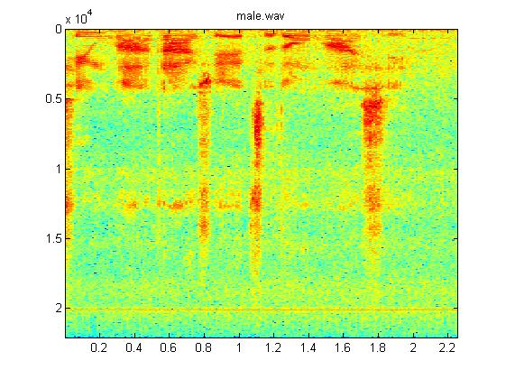

相同一段话的频谱

Slide 12

特征的提取
什么特征具有分类价值？
什么特征容易提取？
什么特征有好的稳定性？
获取什么特征代价比较小？
笔画的多少
像素的多少

Slide 13
模式识别算法评价
分类准确率，分类错误率
速度
判定方法：
交叉验证
留一法

Slide 14
近邻法

Slide 15
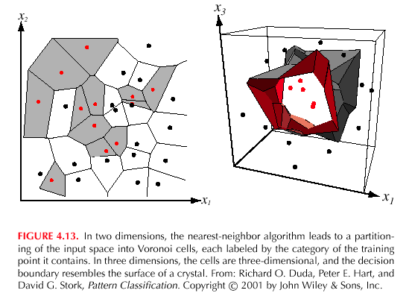
最近邻法

Slide 16
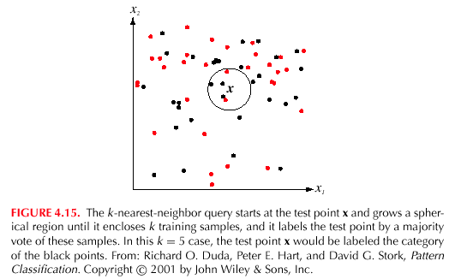
K 近邻法

Slide 17
各种距离度量
1、s 阶 Minkowski 度量
s=1时，
2、欧氏距离度量（ s=2时）

Slide 18
各种距离度量
3、Chebychev距离

Slide 19
各种距离度量
其他距离度量？
相似性与不相似性

Slide 20


相似性度量举例
文本分类
问题：长文本和短文本
问题：亮图像和暗图像
特征的归一化（normalization）

Slide 21
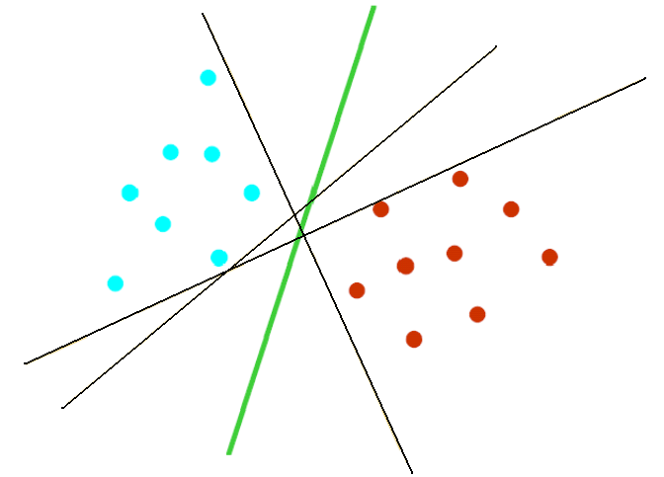
Linearly separable case
Optimal Separating hyperplane
Notes:
衡量分类器性能需要考虑两个因素，经验风险，推广能力
Svm综合考虑这两个因素，给出了结构风险最小化的一个近似的实现

Slide 22
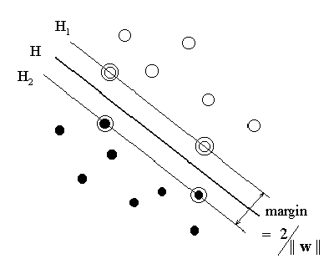
Optimal Hyperplane
Notes:
距离的表示

Slide 23
概念 ：

Slide 24
两类：

Slide 25
Linear classification
Decision surface:

Slide 27
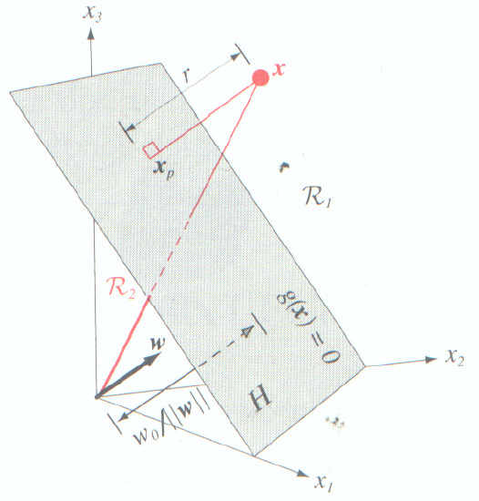
w与超平面垂直
Figure copied from book by Duda

Slide 29
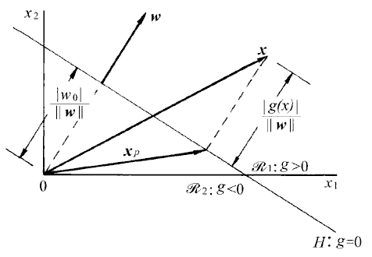
Decision surface (line)
figure copied from reference [4]

Slide 30
Measure of distance
Decomposition of x:

Slide 31
Linear classfication
Decision surface:
Notes:
引入支持向量

Slide 32
Margin of separation
Consider a support vector
then
Margin of separation

Slide 33
Optimization problem
(P)
subject to

Slide 34
Lagrange function
Lagrange multipliers

Slide 35
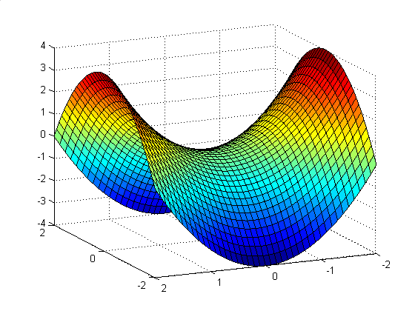
A saddle point
saddle point

Slide 36
Dual Problem
primal function
primal problem
dual function
dual problem
we prefer to solve the dual problem!

Slide 37
Dual Problem
We may now state the dual problem:

Slide 38
Some discussions
1.
depends only on the input patterns in the form of
a set of dot products,
2.
support vectors determine the hyperplane
Notes:
1. 对于核的引入很重要

Slide 39
Linearly non-separable patterns
hard margin
introduce slack variables
Notes:
More difficult case

Slide 40
Linearly non-separable patterns
Support
vectors
Support
vectors
slack
variables

Slide 41
Optimization Problem
subject to
: upper bound of misclassification error
: tradeoff between complexity of the machine
and the number of nonseparable points

Slide 42
Dual Problem

Slide 43
Summary
linear separable
optimal hyperplane
large margin
support vectors
dual problem
quadratic programming
linear nonseparable
slack variables
soft margin
nonlinear
?
Notes:
关于二次规划，1. 可以找到错误曲面的全局最优解，错误指期望的响应与支持向量机输出之差
2. 高效的计算
数据维数很高，样本数很少时，使用对偶规划有益
软间隔，只是错误率的近似
支持向量，提取训练样本的一个自己作为支持向量，通常占很小比例

Slide 44
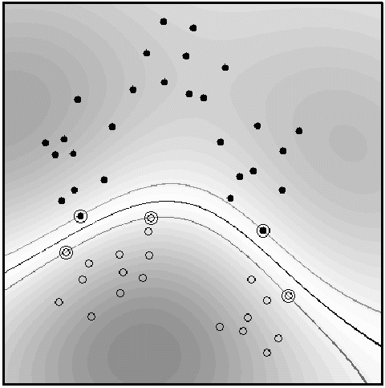
The Non-separable Case
Using Slack variables
Nonlinear Method

Slide 45
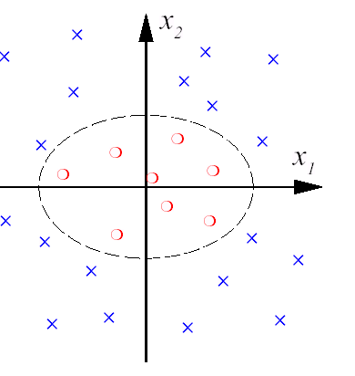
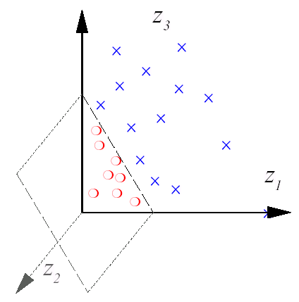
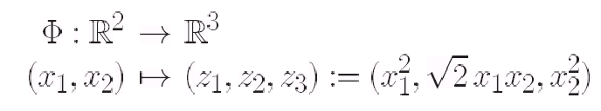
From Linear to Nonlinear
Increase Dimension and Use Linear Method in High Dimensional Space——Generalized Linearity
An Example

Slide 46
From Linear to Nonlinear (Cont.)
Why ? —Input Space is not proper Feature Space

Slide 47
Computation
Maximize the Wolfe dual problem (training):
The Classifier (testing)
Only dot product is needed!

Slide 48
Kernel Examples
Polynomial kernel:
RBF kernel:
Sigmoid kernel:

Slide 49
简单例子
2
+1类 = x1 x2
-1类 = x3 x4
1
2

Slide 50
解答 图示
2
1
2

Slide 51
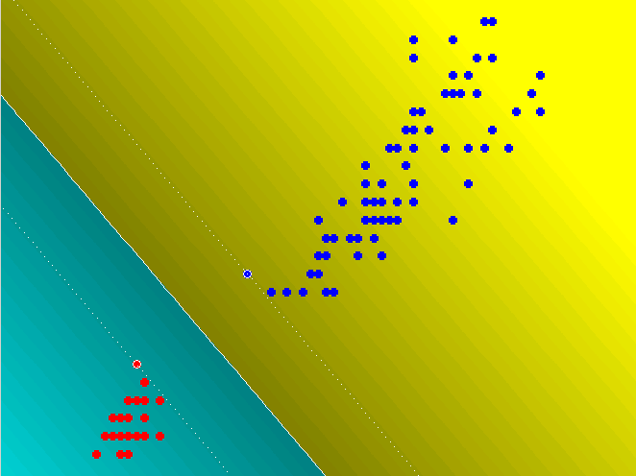
线性可分
样本数=120
核=一次多项式
支持向量/总样本数的=1.7%

Slide 52
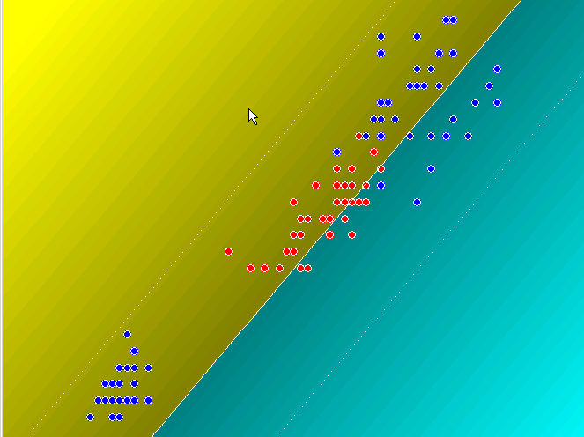
线性不可分
样本数=120
核=一次多项式
支持向量/总样本数=100%
@并没有很好分开

Slide 53
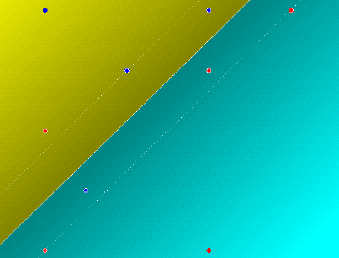
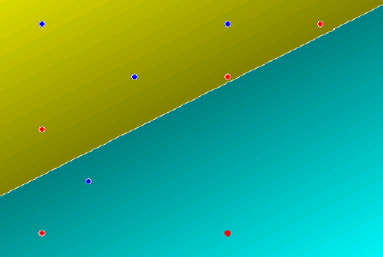
松弛因子的影响
C=10⁵
C=10⁻⁸

Slide 54
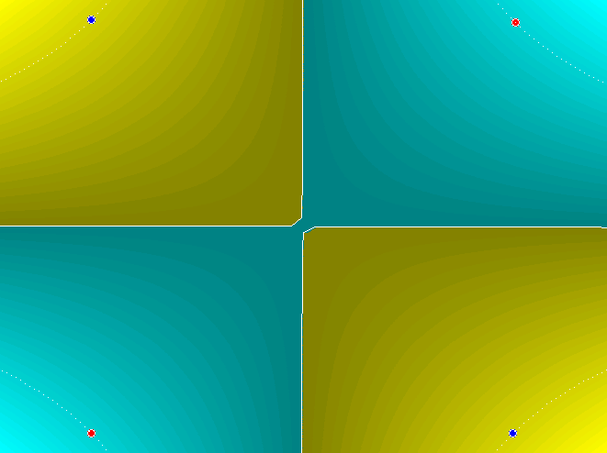
XOR问题分类面

Slide 55
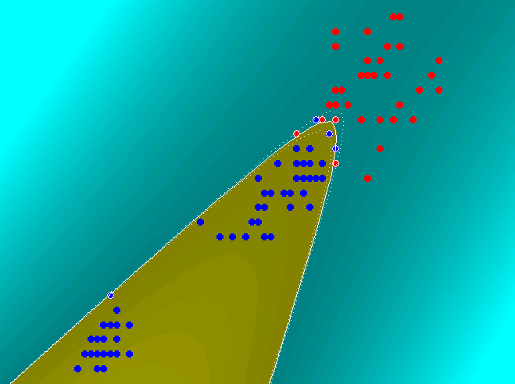
非线性问题的例子
样本数=120
核=二次多项式
支持向量/总样本数的=8.3%
@很好分开

Slide 56
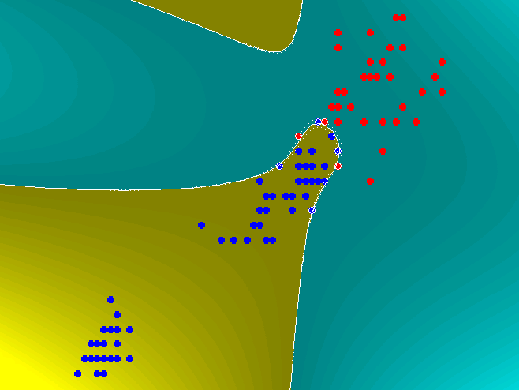
采用三次多项式
样本数=120
核=三次多项式
支持向量/总样本数的=7.5%
@很好分开但是分类面不同

Slide 57
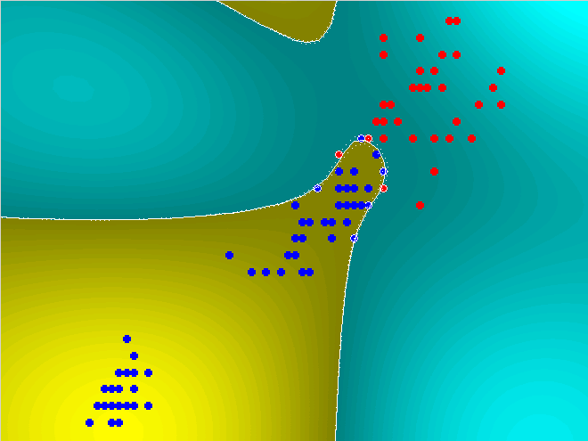
高斯核 sigm=1
样本数=120
核=高斯核
支持向量/总样本数的=8.3%
@高斯核相当于无限阶的多项式

Slide 58
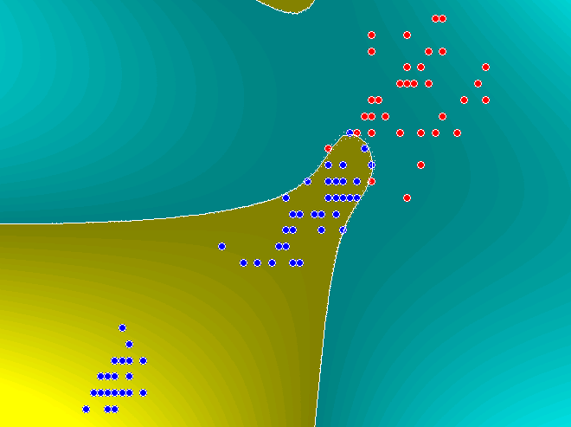
高斯核 sigm=2
样本数=120
核=高斯核
@sigma的选取影响很大

Slide 59
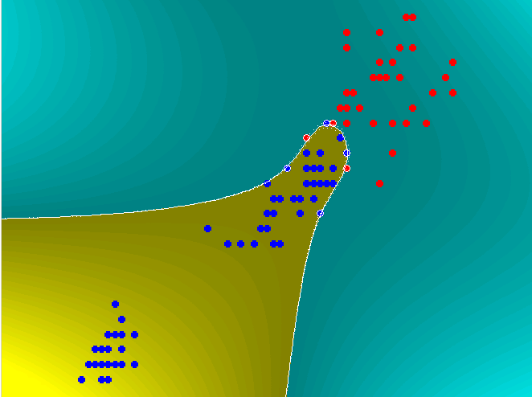
高斯核 sigm=3
样本数=120
核=高斯内核
支持向量/总样本数的=7.5%
@高斯内核相当于无限阶的多项式

Slide 60
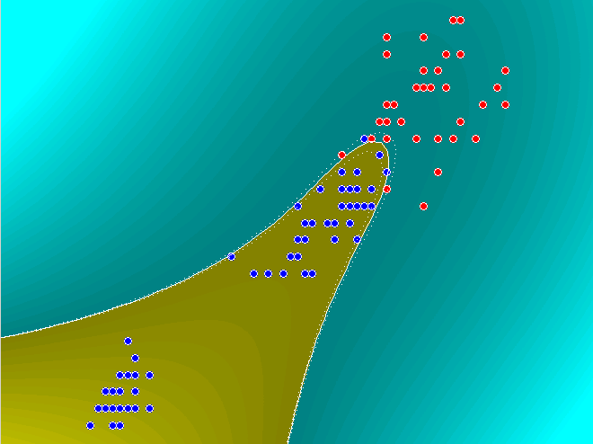
高斯核 sigm=9
样本数=120
核=高斯核
@sigma增加，运算量增加

Slide 61
核的选择是很重要的
核的选择对结果有很大的影响
但是核的选择却没有统一的方法，大多要靠经验

Slide 62
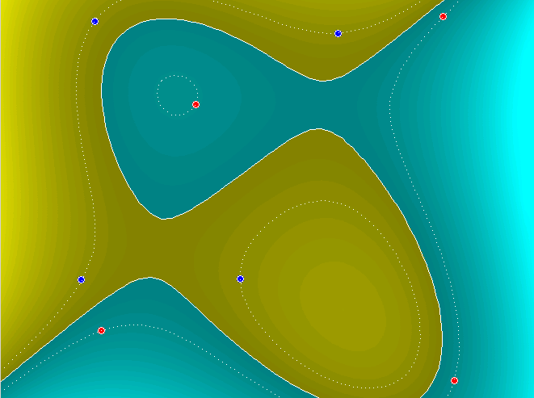
相互包含的例子
样本数=8
核=三次多项式
支持向量/总样本数的=100%
@小样本效果好

Slide 63
多类问题
c-1个两类问题
个线性判别函数

Slide 64
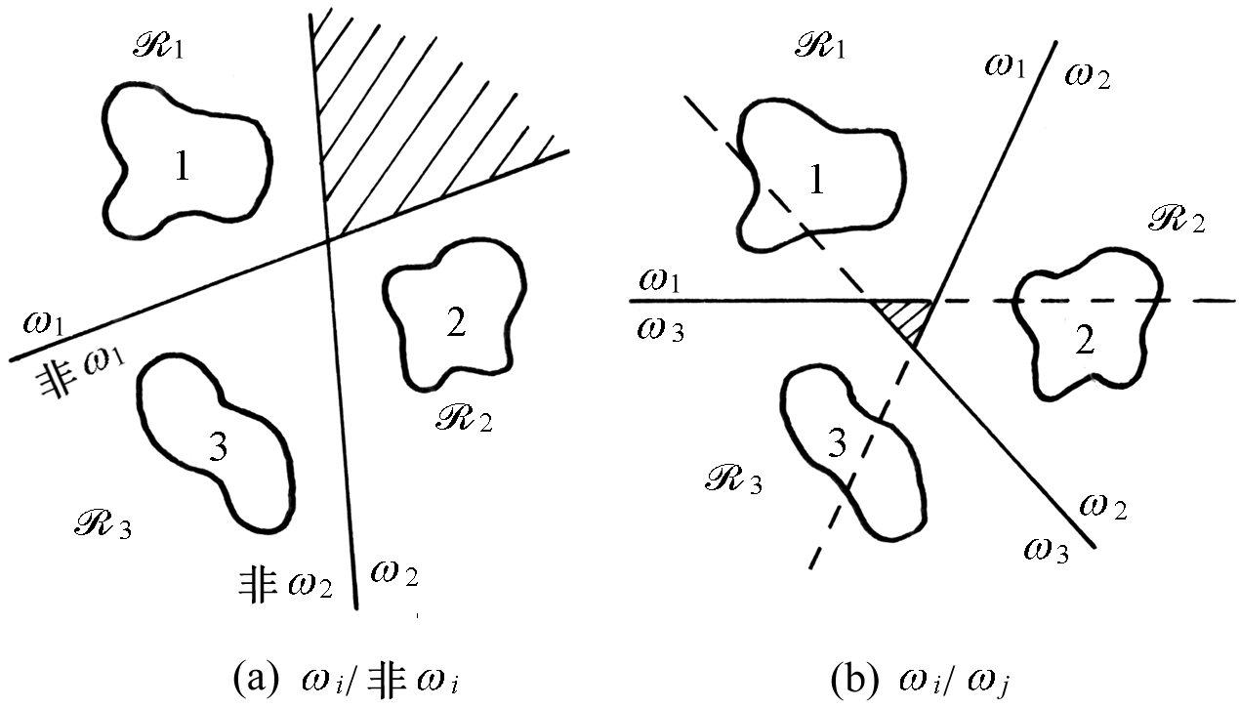
多类问题

Slide 65
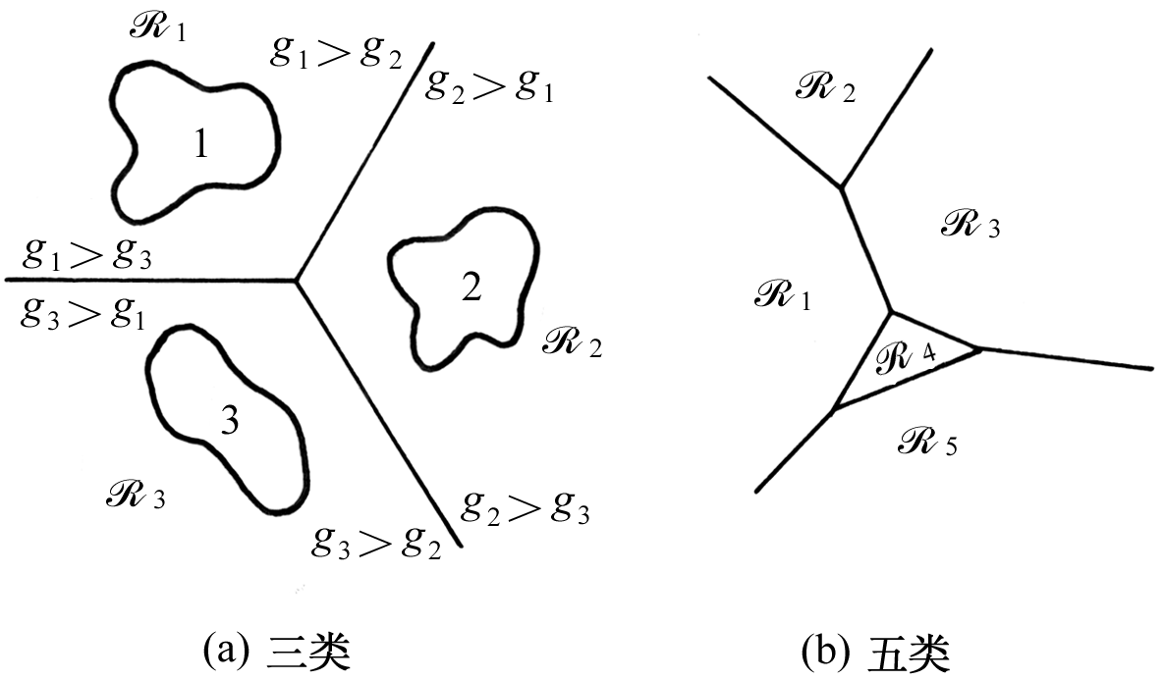
多类问题

Slide 66

问题：过拟合(overfitting)
Notes:
Quality: fewer bugs in the product means that fewer bugs ship and a higher percentage of them are found
Ship date: Bugs add risk – you do not know how long it will take you to fix them.
if you have few bugs, you are in near-shipping condition at all times
Attitude: work with better code, fewer bugs to fix, more certainty, ship mode can be fun! NO MORE DEATH MARCHES
Future versions:
Code lives on in many versions – Money 1.0 code still in the product
Poor code is tougher to work with
Productivity:
Developers: by introducing fewer bugs you can implement more features in same amount of time
Testing: Less time spent on managing bugs, less time blocked
Bottom line: By CREATING FEWER BUGS
Ship a better quality product
More likely to ship on time
Life is more fun
Next version will be easier and better
You will implement more features for your customers
This is the whole point of this class

Slide 67
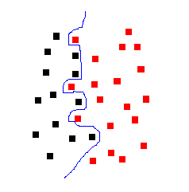
问题：过拟合(overfitting)
Notes:
Quality: fewer bugs in the product means that fewer bugs ship and a higher percentage of them are found
Ship date: Bugs add risk – you do not know how long it will take you to fix them.
if you have few bugs, you are in near-shipping condition at all times
Attitude: work with better code, fewer bugs to fix, more certainty, ship mode can be fun! NO MORE DEATH MARCHES
Future versions:
Code lives on in many versions – Money 1.0 code still in the product
Poor code is tougher to work with
Productivity:
Developers: by introducing fewer bugs you can implement more features in same amount of time
Testing: Less time spent on managing bugs, less time blocked
Bottom line: By CREATING FEWER BUGS
Ship a better quality product
More likely to ship on time
Life is more fun
Next version will be easier and better
You will implement more features for your customers
This is the whole point of this class

Slide 68
数据的多项式拟合
y(x,w)是多项式函数

Slide 70
拟合误差

Slide 71
模型选择
多项式的阶次M=?
M小，模型简单，不够灵活
M大，模型复杂，灵
活
交叉验证：
训练集，验证集

Slide 72
过拟合
用最小二乘方法来寻找模型的参数是最大似然的一个特例
过拟合问题是最大似然方法的一个普遍特性
采用Bayesian方法可以避免过拟合问题。

